Slide 1
Naïve Bayes
Eldin Sahbaz
Eli Goldweber
Puhup Manas

Slide 2
Sentiment Analysis
The process of determining whether a piece of writing is positive, negative or neutral
Can be used to
Improve campaign success
Improve product messaging
Feedback on organization
Accuracy Goal
Anyone who says they’re getting better than 70% [sentiment analysis] is lying, generally speaking.”

Slide 3
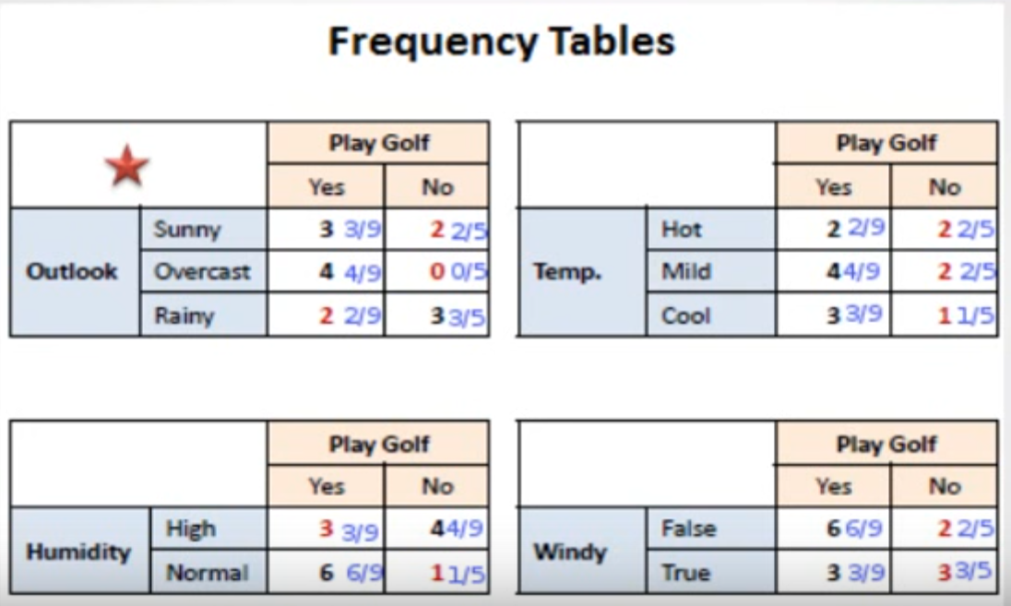
How Naïve Bayes Works

Slide 4
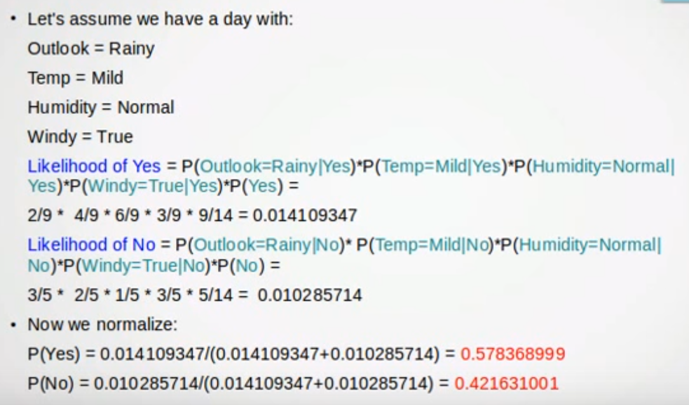
How Naïve Bayes Works

Slide 5
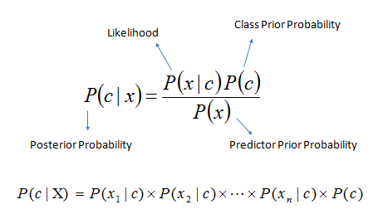
Bayes Formula

Slide 6
Our Results

Slide 7

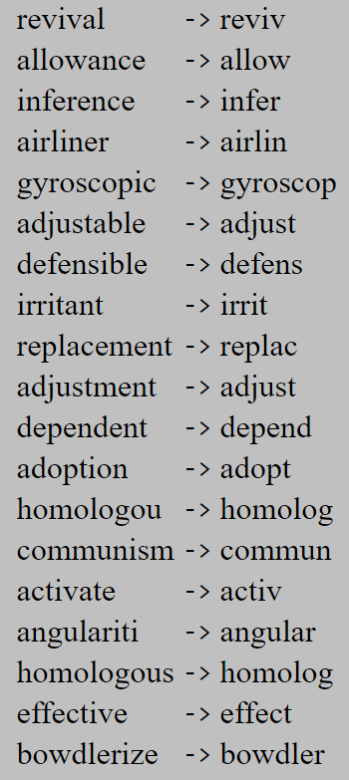
Features Added
Stemmer
Actively Learning
Critique new inputs
Add to dictionary

Slide 8
Demo

Slide 9
Sources
https://www.linkedin.com/pulse/importance-sentiment-analysis-social-media-christine-day
https://www.youtube.com/watch?v=XcwH9JGfZOU
https://www.lexalytics.com/technology/sentiment
http://snowball.tartarus.org/algorithms/porter/stemmer.html
https://inclass.kaggle.com/c/si650winter11/data

